Slide 1
JavaScript Fundamentals
By Rasmus Vestergaard Hansen

Slide 2
Agenda
Introduction
Language Overview
Language Features (mixed with samples and exercises)
JavaScript and the dom
Language Quirks (mixed with samples and exercises)
More exercises
Notes:
Start med at spørge hvad deres erfaring er med JavaScript, html, css etc.
I will dive a bit deeper than most ”fundamentals” courses might do. The reason for this, is that I think it is important to understand how javascript works in order to be efficient and avoid pitfalls.
You are all seasoned developers, so we will go quickly through the basic stuff, and focus on how to be efficient in javascript.
Fundamentals != the basic stuff
Fundamentals == the important stuff, fundamental to understanding and learning javascript properly.

Slide 3
Language Overview
”JavaScript is classified as a prototype-based scripting language with dynamic typing and first-class functions. This mix of features makes it a multi-paradigm language, supporting object-oriented,^{[6]} imperative, and functional^{[1][7]} programming styles.” [Wikipedia]
Notes:
Prototypebased: ”Inheritance” is obtained through delegation to other objects.
Scripting language: Interpreted – ie. Not compiled ahead of time. But compile by the js runtime
Dynamic typing: Types are not checked before runtime. Vars don’t have types, values have types.
Object oriented in the literal sense of the word, NOT class oriented.
Imperative: describes computation in terms of statements that change a program state
Declarative or functional: describes desired result.

Slide 4
Language Features
Types
Imperative and Structured
Dynamic
Values have types, variables do not
Functional
Functions are first class objects.
Lexical Scope
Closures
IIFEs and Modules
Object oriented – but NOT class oriented
Notes:
Types: Javascript has types contrary to what some people are saying. Coercion and dynamic typing might make it seem like there are no types.
Imperative and structured: if, while, switch, for
Dynamic: x can be a number and later a string, object, function, etc.
Functional: Functions are first class, and can be passed around, bound, curried, etc. -> Declarative programming

Slide 5
Imperative and structured
Control structures
Variables
Notes:
Show imperative1.js
Show node repl. Declare string, length, array, object
Get people to play around with a node repl for a few minutes

Slide 6
Types
WAT
null
undefined
boolean
number
string
object
function
array
…
Notes:
types.js
Objects are property bags pretty much. Good for hashmaps
Functions are callable objects
Arrays are also objects, but they have a length property, and should only be used as arrays to avoid confusion

Slide 7
Dynamic
Dynamic Typing
Object based
Run-time evaluation (considered evil)
Notes:
- Object based: functions are objects, than can be passed around

Slide 8
Functional
Functions are first class citizens, and can be passed around, have properties, and can be nested.
Powerful features
Notes:
Function composition, chaining, currying, etc.
More on that in later exercises

Slide 9
Lexical Scope
function foo() {
var a = 2;
function bar() {
console.log( a ); // 2
}
bar();
}
foo();

Slide 10
Lexical Scope 2
- Function, not block scope
function loop () {
var count = 0;
console.log(i);
// Some other logic taking up a lot of lines
for(var i=0; i<100; i++) {
count++;
}
return count + i;
}
loop(); // Result = ?
Notes:
Count + i?
Console.log(i);

Slide 11
Exercises Part 1
- To get our feet wet
bit.ly/jsCourse

Slide 12
Closures
”Closure is when a function is able to remember and access its lexical scope even when that function is executing outside its lexical scope.”
Notes:
Lex1 – is this closure?
Closure1 - > observed closure

Slide 13
IIFEs and Modules
Immediately Invoked Function Expressions
Modules
Notes:
IIFEs, see closure 3
Modules

Slide 14
Prototypes
”Prototype-based programming is a style of object-oriented programming in which behaviour reuse (known as inheritance) is performed via a process of cloning existing objects that serve as prototypes. This model can also be known as prototypal, prototype-oriented, classless, or instance-based programming. Delegation is the language feature that supports prototype-based programming.”
Notes:
Most people make the mistake of trying to cram javascript into the classical class oriented programming paradigm. It is not very well suited for that
You will be working against the language.
Show proto0
Show prototype3

Slide 15
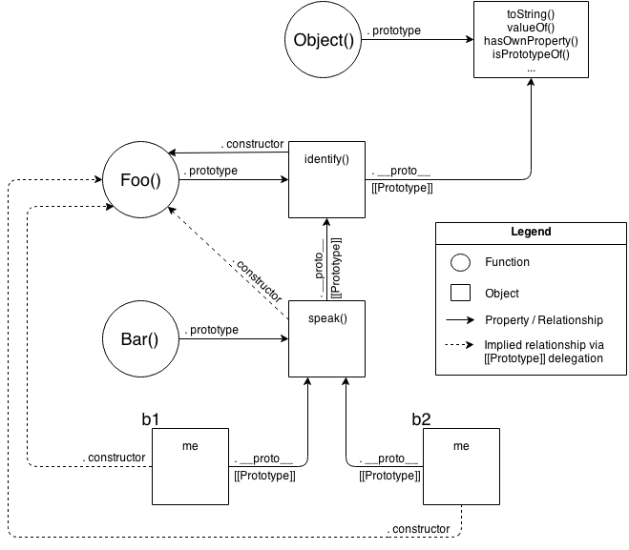
Prototypes
Prototypal Inheritance
Mental model
of standard
prototypal
inheritance
Notes:
Proto3

Slide 16
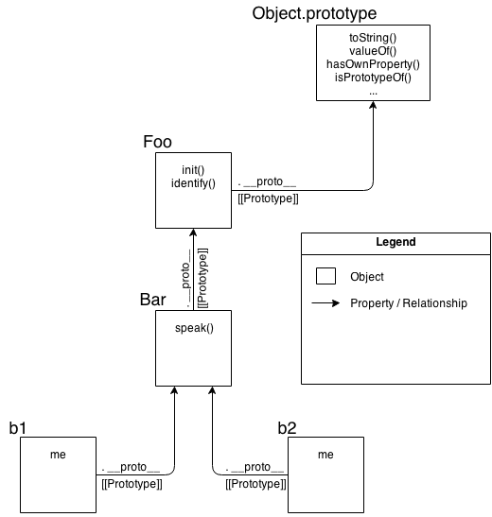
OLOO Delegation
Mental model for OLOO style delegation
”Objects Linked to Other Objects”
Notes:
Proto4
Then show proto1 and proto2

Slide 17
JavaScript and the DOM
What is the DOM?
JavaScript can be used to read the DOM, manipulate it, add event listeners to elements and much more.
Exercise – build a simple YouTube search using jQuery to manipulate the DOM. Start with this skeleton
Notes:
I will not go too much into detail with the dom, since hopefully you will not be doing too much dom manipulation when you are using AngularJS
Simple dom manipulation in console
$(‘d1’).append(‘<p>YO</p>’)
$(‘d1’).insertAfter($(‘div’))
dom2.html build simple youtube search

Slide 18
Language Quirks
- Or common misunderstandings
Hoisting of functions and vars
Coercion
Truthy and falsy values
== vs ===
this

Slide 19
Hoisting
Compiler processes variable and function declarations first
Function declarations are hoisted – function expressions are not
Notes:
Show hoisting1, hoisting2
Then bullet,
Then hoisting 1a, 2a
The 3a – Note typeError, not referenceError
Function declarations are hoisted, but function expressions are not!

Slide 20
Coercion
Values can be implicitly or explicitly coerced to other types
== vs ===

Slide 21
Falsy values
All of JavaScript's values can be divided into two categories:
Values that will become false if coerced to boolean
Everything else (which will obviously become true)
Falsy values:
undefined
null
false
0, and NaN
“”

Slide 22
this
function f(val) {
this.value = val; // What is this?
}
Notes:
Well it depends on the call site:
Is the function called with new (new binding)? If so, this is the newly constructed object.
var bar = new foo()
Is the function called with call or apply (explicit binding), even hidden inside a bind hard binding? If so, this is the explicitly specified object.
var bar = foo.call( obj2 )
Is the function called with a context (implicit binding), otherwise known as an owning or containing object? If so,this is that context object.
var bar = obj1.foo()
Otherwise, default the this (default binding). If in strict mode, pick undefined, otherwise pick the globalobject.
var bar = foo()

Slide 23
Exercises 2
bit.ly/jsCourse

